Slide 1

welcome

Slide 2
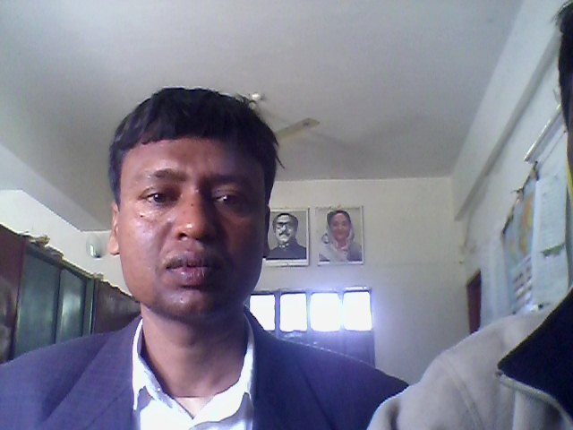
Teacher Identity
Md: Abdul Alim ID-09
Assistant Teacher(English)
Dr. Abdus Sobhan High School
Kahaloo, Bogra.
Mobile No-01717423804

Slide 3
Lesson Introduction
Class : Eight
Subject : English 1st Paper
Unit : 3
Lesson :6
Time : 50 minutes
Date : 06-02-2014

Slide 4

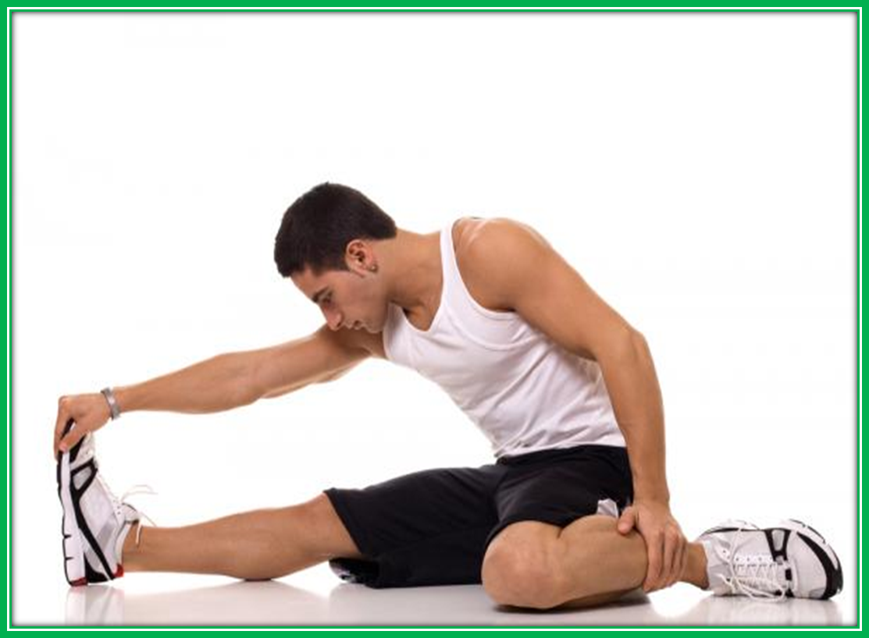

Slide 5
To day’s lesson
Title: Physical exercise
Out comes
After Studied this lesson, they will be able to
To tell about physical exercise.
To know about indoor/outdoor games.
To know necessary about regular physical exercise.

Slide 6

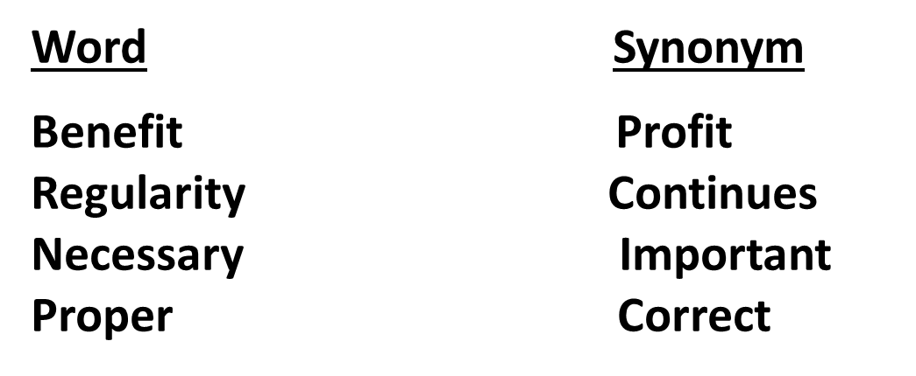

Slide 7
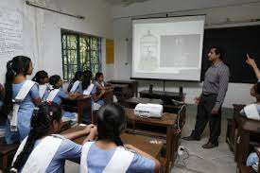
Reading test

Slide 8
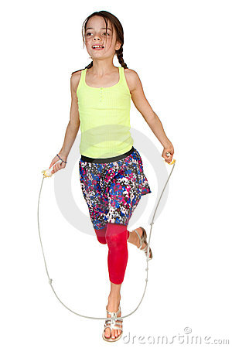
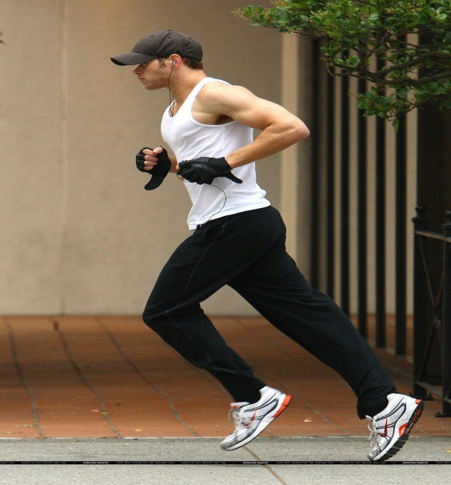

Look at the Pictures
Skipping
Jogging
Stretching
Work – 1 (Individual)
How many physical exercise are there?
Answer: There are two kinds of physical exercise.

Slide 9
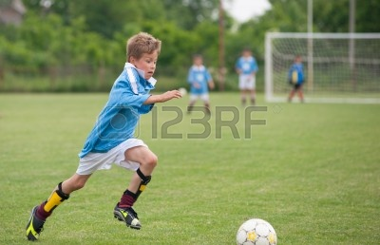
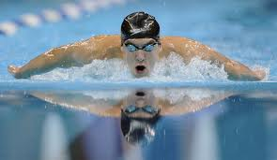
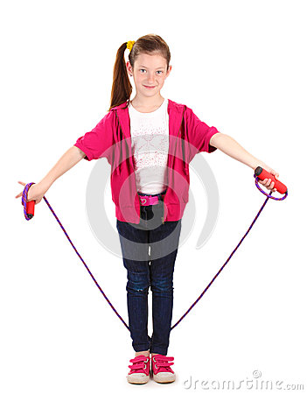
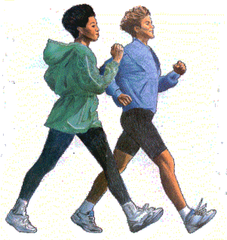
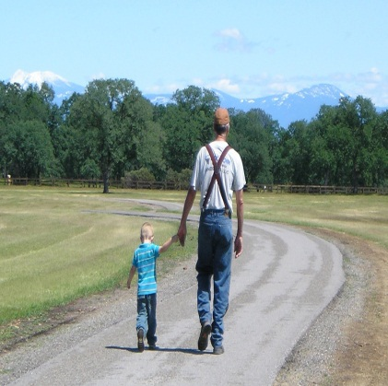
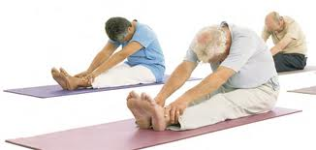
Look at the Pictures
Sports
Swimming
Skipping
jogging
Walking
Stretching

Slide 10

Pair work
Write the name which are indoor games?
Answer: Stretching.
Write the name which are outdoor games?
Answer: Playing sports,swimming,skipping,
Jogging,walking.

Slide 11
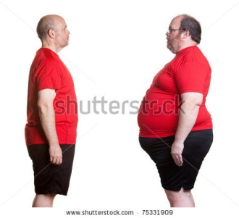
Look at the pictures
After Exercise
Before Exercise

Slide 12
Work (Group )
Whey do you need regular physical exercise?
Answer: We need regular physical exercise to keep fit our body for working.
What does physical exercise teach you?
Answer: Physical exercise teach us to make our body strong and cheerful.

Slide 13


Evaluation:
Choose the best answer
Which game is indoor game –
Playing sports (b) Swimming (C) walking (d) Stretching
Ans: (d) Stretching
2.Which game is outdoor game-
(a) Stretching (b) Table tennis (c) Chess (d) Playing sports
Ans: (d) Playing sports
3.Which game do you like best-
(a) Stretching (b) Table tennis (c) Chess (d) Playing sports
Ans: (a) Stretching

Slide 14
Home Work
Write a paragraph about necessary of physical exercise.

Slide 15

Thank you

